Slide 1

JICA’S APPRECIATION

Slide 2

JICA’S APPRECIATION

Slide 3
WHY DID WE GET APPRECIATION
For Accurate Representation of Flood Situation in the project area(Damage)
For Representation and Explaining in detail of Design of different type of protection work.
For Presentation of Activity plan for civil works next two dry seasons
Progress in agriculture component and plan for next FY
Presentations of civil works monitoring format

Slide 4
Commitments Made to JICA
Commitments to JICA | Follow ups
1. Inclusion of Type B1 protective work for 200m pilot basis | Consultant had been notified to find suitable reach
2. Quality Monitoring Civil Work Plan | 1. QA format finalized 2. Specification drafted (Needs immediate finalization)
3. Improvement of Embankment Turfing | 1. No standard test could be identified2. Only visual inspection.
4.Photos of condition after major construction activities shall be taken at a regular intervals, e.g. every 200 m, and added to the report | 1.Embankment compaction and turfing will be videographed by single continuous shot. 2.A drone with camera will be procured to picturize different stages of construction.

Slide 5
Commitments Made to JICA
Photos of condition after major construction activities shall be taken at a regular intervals, e.g. every 200 m, and added to the report.
In case of Type A:
Before the construction of protection work
Before applying 100mm thick sand layer
After applying 100mm thick sand layer
After applying Geotextile Filter Cloth
After applying 100 m thick assorted filter
After applying CC blocks

Slide 6
Commitments Made to JICA :QA PLAN

Slide 7

Commitments Made to JICA :Turfing
Shaping of embankment crest and slope in design level and in desired compaction.
Selection of turfing source.
Cutting and transporting turf in 250mmx250mmx75mm size.
Planting turf in embankment slope without any gap in staggered formation within February.
Continuous watering upto defects liability period.
Application of fertilizer in proportion N:P:K=16:5:12
Replanting if needed in any defect area.

Slide 8
Work Program for 2020-21

Slide 9
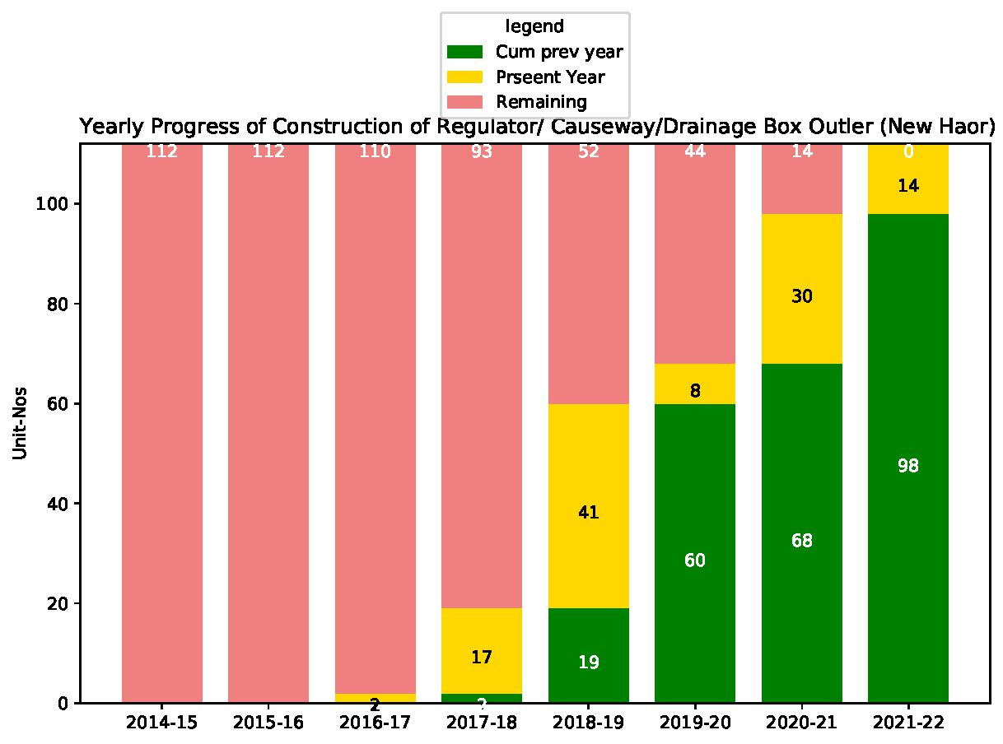
Activity Plan for Next TWO Years?

Slide 10
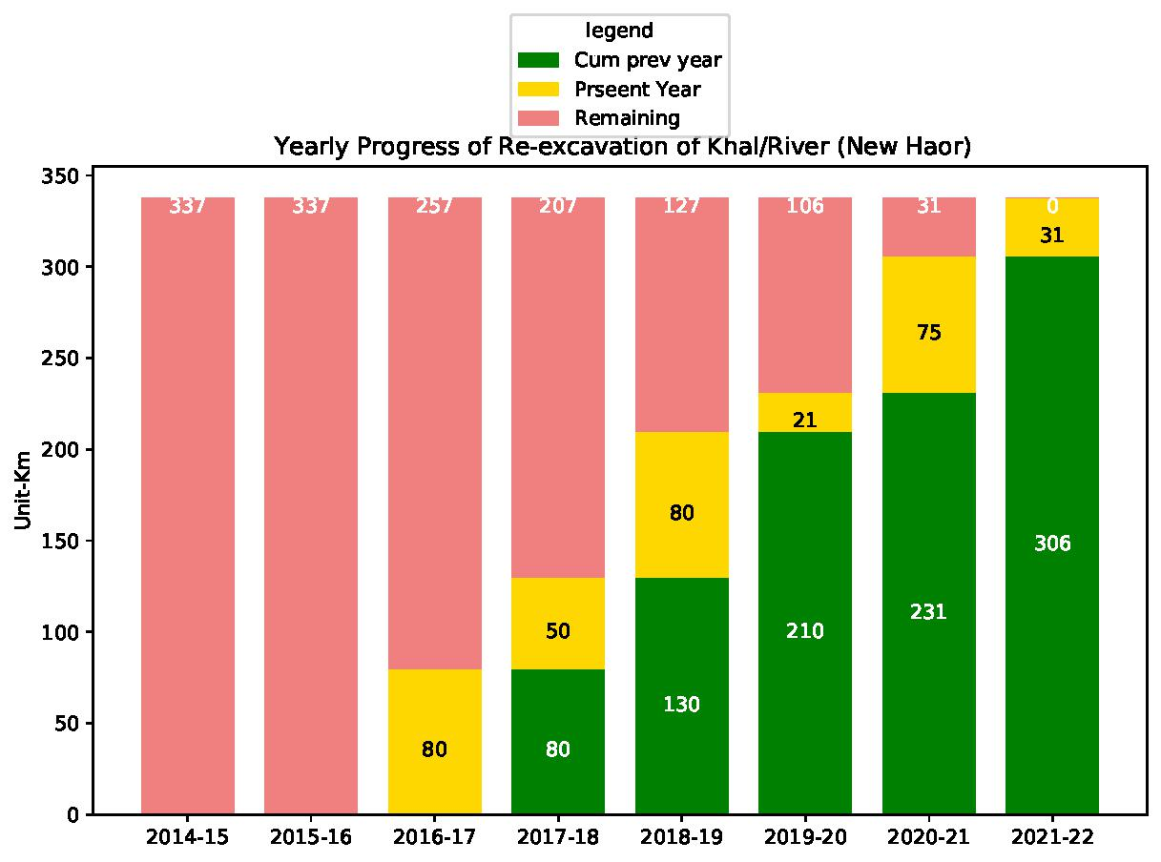
Progress of Re-excavation of Khal/River (New Haor)

Slide 11
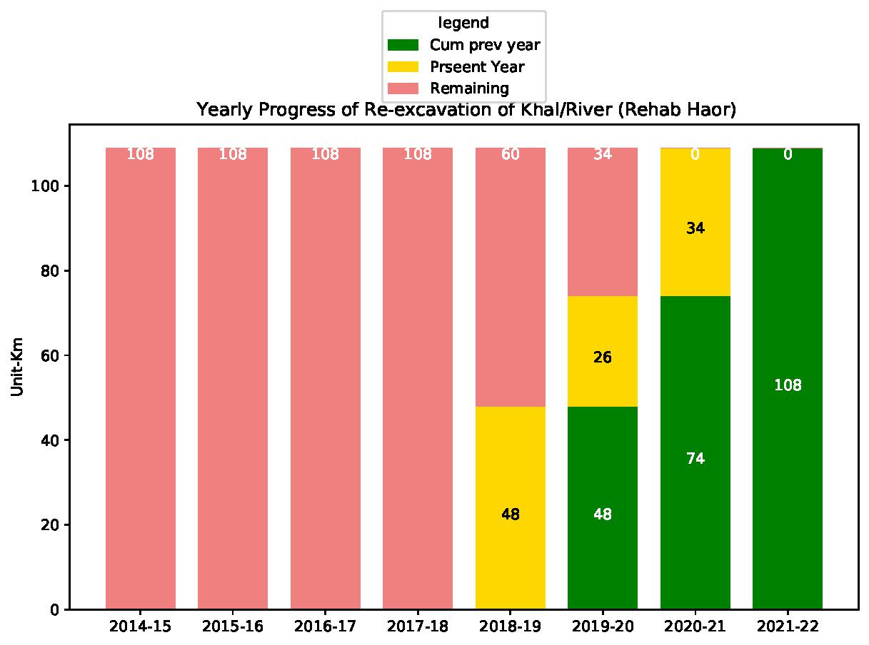
Progress of Re-excavation of Khal/River (Rehab Haor)

Slide 12
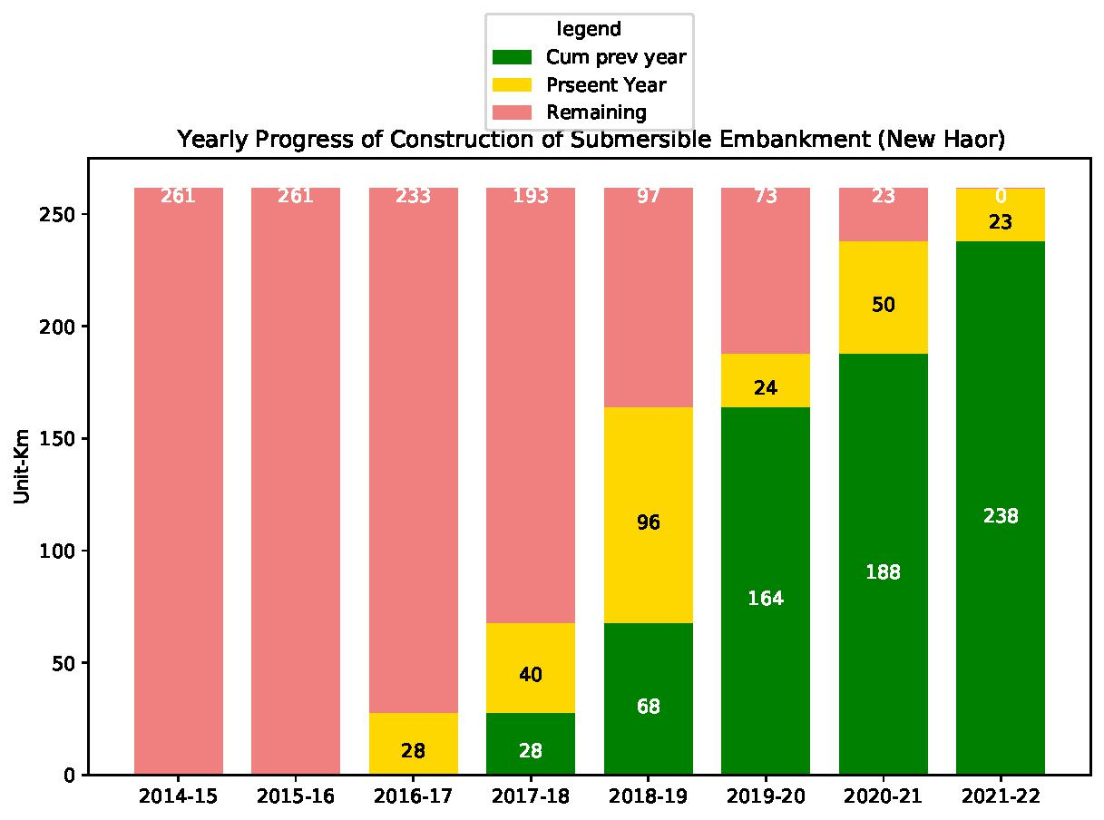
Progress of Construction of Submersible Embankment (New Haor)

Slide 13
Yearwise Civil Works Expenditure

Slide 14
Specification What Does It Contain?
How ,when and by whom measurement for Individual work Item will be given.
How ,when ,by whom and in what frequency Quality Assurance Tests for Individual work items will be performed.
Schedule of Tests for different work Items.

Slide 15
Why Measurement Important
Price=Rate*Quantity
As per GCC clause 60.2 contractor shall be paid to the quantity of work it has done by the rate stated in BoQ.So Rate is Fixed Quantity Variable
To find Quantity We need Accurate Measurement

Slide 16
What Did We Do Faulted?
GCC clause 66.1 in STD states that PE is shall make payment amount certified by the project manager within 28 days with making deduction for advance payment and retention money. Any other deduction may arise but it have to be decided by project manager.
If PE make late payment contractor shall be paid interest on the next IPC as per GCC 67.1.
Last Year We Deducted 10% Special Security and We are in the risk of Paying Interest if contractor claims. In One analysis this amount about BDT 5 lakh/month
This Year we want to Avoid this situation. We want to pay Contractor Monthly Invoices. So regular measurement by JMT is Necessary.

Slide 17
Flow Chart For Measurement
All the Measurement will be taken by JOINT MEASUREMENT TEAM (JMT)
Concerned XEN as Project Manager will Check and Recommend for Approval of Measurement to the Project Director
PD shall approve all the Measurement

Slide 18
Measurement Constitution of Joint Measurement Team (JMT)
Constituting Members | Designation
Concerned Sub-Divisional Engineer | Convener
Concerned SAE/SO. | Member
Concerned Field Inspector. | Member
Representative of the Contractor | Member
Concerned Field Supervision Engineer. | Member Secretary

Slide 19
Measurement Work Scope of JMT
Submit Measurement Every 15days in standard format. (Annex-II: Standard Forms for Measurement)
Ensure Quality Control tests performed properly
Submit monthly quality control report for every site/reach/structure..
After Completion prepare a defect liability schedule

Slide 20
Measurement Format for CC Block

Slide 21
Measurement Format for RCC Work

Slide 22
Measurement Format for Reinforcement

Slide 23
Measurement Format for Earth Work

Slide 24
Measurement Format for Earth Work

Slide 25
Measurement Format for General Items Not Covered Above

Slide 26
Summary of Measurement

Slide 27
Standard Sampling and Testing for Embankment
Sl | Name of Test | Frequency of Test | Test Method
1 | Atterberg's Limit (Plastic Limit & Liquid Limit) | 1. For each source of fill materials 2. One Sample for each 10,000 Cum of fill material 3. Change in the Characteristics of the material noticed on visual examination. | ASTM D 4318 or Equivalent
2 | Grain Size Distribution | As stated above | ASTM D 422 or Equivalent
3 | Modified Proctor Test | As stated above | ASTM D 1557 & ASSTO T 180 D
4 | Moisture Content | I .For each 5000 cum of fill material 2. As per direction of the Project Manager. | ASTM D 4346 & ASTM D 4944 or V Equivalent
5 | Field Dry Density Test | 1. One Sample for each 1000 sqm of compacted surface in each layer 2. As per direction of the Project Manager. | AAHSTO T191 or Equivalent

Slide 28
Standard Sampling and Testing for CC Block
Sl | Name of Test | Frequency of Test | Test Method
1 | Cement: Fineness Soundness Initial Setting Time and Final Setting Time Compressive Strength Tensile Strength Unit Weight | For each fresh Consignment arriving at Site For each 100 M. Ton As approved or directed by the Project Manager. | ASTM C786, ASTI C403, ISO 679:2009 or Equivalent
2 | Fine Aggregate (Sand) i) Fineness Modulus | 1(one) Sample for each 350 Cum or part thereof At least 1 Sample in a week As approved or directed by the Project Manager. | ASTM C 33 or Equivalent
3 | Coarse Aggregate (Stone Chips) Gradation Test | 1(one) Sample for each 700 Cum or part thereof At least 1 Sample in a week As approved or directed by the Project Manager. | ASTM C330, AASHTO T-85, BS- 812, ASTM C-535 or Equivalent
4 | Water Suitability of Water for Concrete Mixing | For Each source of Water As approved or directed by the Project Manager. | BS EN BS EN 1008:2002
5 | Concrete Concrete Core Test | Concrete Core Test will be carried out for at least one block for each days casting As approved or directed by the Project Manager. | BS 1881, ASTM C-42 Or similar standard

Slide 29
Standard Sampling and Testing for Geo Textile
Sl | Name of Test | Frequency of Test | Test Method
1 | Geotextile Filter Materials:
 | i. Opening Size 0₉₀ | 1.for each quantity of 10,000 square meter 2.At Least 1 test for Total Requirements in Reach of Work if that is less than 10000 square meter | EN ISO 12956
 | ii. Mass per unit area | 1.for each quantity of 10,000 square meter 2.At Least 1 test for Total Requirements in Reach of Work if that is less than 10000 square meter | BS EN 965
 | iii. CBR Puncture Resistance | 1.for each quantity of 10,000 square meter 2.At Least 1 test for Total Requirements in Reach of Work if that is less than 10000 square meter | EN ISO 12336
 | iv. Tensile Strength (machine direction- MD or cross machine direction-CMD) | 1.for each quantity of 10,000 square meter 2.At Least 1 test for Total Requirements in Reach of Work if that is less than 10000 square meter | EN ISO 10319

Slide 30
Standard Sampling and Testing for Geo Textile
Sl | Name of Test | Frequency of Test | Test Method
 | Minimum thickness | 1.for each quantity of 10,000 square meter 2.At Least 1 test for Total Requirements in Reach of Work if that is less than 10000 square meter | EN ISO 9863
 | Grab Tensile Strength | 1.for each quantity of 10,000 square meter 2.At Least 1 test for Total Requirements in Reach of Work if that is less than 10000 square meter | ASTM D 4632
 | Vertical Permeability under 2Kn/m² & 200Kn/m² pressure | 1.for each quantity of 10,000 square meter 2.At Least 1 test for Total Requirements in Reach of Work if that is less than 10000 square meter | ASTM D4491
 | viii. Horizontal Permeability under 2Kn/m² pressure | 1.for each quantity of 10,000 square meter 2.At Least 1 test for Total Requirements in Reach of Work if that is less than 10000 square meter | ASTM D4491

Slide 31
Standard Sampling and Testing for Geo Textile
Sl | Name of Test | Frequency of Test | Test Method
 | Minimum thickness | 1.for each quantity of 10,000 square meter 2.At Least 1 test for Total Requirements in Reach of Work if that is less than 10000 square meter | EN ISO 9863
 | Grab Tensile Strength | 1.for each quantity of 10,000 square meter 2.At Least 1 test for Total Requirements in Reach of Work if that is less than 10000 square meter | ASTM D 4632
 | Vertical Permeability under 2Kn/m2 & 200Kn/m2 pressure | 1.for each quantity of 10,000 square meter 2.At Least 1 test for Total Requirements in Reach of Work if that is less than 10000 square meter | ASTM D4491
 | viii. Horizontal Permeability under 2Kn/m² pressure | 1.for each quantity of 10,000 square meter 2.At Least 1 test for Total Requirements in Reach of Work if that is less than 10000 square meter | ASTM D4491

Slide 32
Standard Sampling and Testing for Geo Textile
Sl | Name of Test | Frequency of Test | Test Method
 | Minimum thickness | 1.for each quantity of 10,000 square meter 2.At Least 1 test for Total Requirements in Reach of Work if that is less than 10000 square meter | EN ISO 9863
 | Grab Tensile Strength | 1.for each quantity of 10,000 square meter 2.At Least 1 test for Total Requirements in Reach of Work if that is less than 10000 square meter | ASTM D 4632
 | Vertical Permeability under 2Kn/m² & 200Kn/m² pressure | 1.for each quantity of 10,000 square meter 2.At Least 1 test for Total Requirements in Reach of Work if that is less than 10000 square meter | ASTM D4491
 | viii. Horizontal Permeability under 2Kn/m² pressure | 1.for each quantity of 10,000 square meter 2.At Least 1 test for Total Requirements in Reach of Work if that is less than 10000 square meter | ASTM D4491

Slide 33
Total number of Test for SUNM-PW-07
Type A Protective Work Start: Finish: Length: Start of reporting period: Report Finished Date:
Work Item/Material | Unit | Work Executed/Material Consumed in Last 30 days | Name of Test | Relevant Test Standard | No of Test Required as Per Specification | No of Test Performed | No of Test Passing Threshold Value | No of Test Do Not Passing Threshold Value | Remarks
CC Block | Nos | 88751 | Compressive Strength by Core Cutting | ASTM C42 | 18
Cement | Kg | 1355700 | Fineness Test | ASTM C786 | 14
 |  |  | Compressive Strength | ASTM C151 | 14
 |  |  | Setting Time | ASTM C403 | 14
Fine Aggregate | cum | 2382 | Fineness Modulus | ASTM C127 | 7
Coarse Aggregate | cum | 5199 | Gradation Test | ASTM C36 | 8
Geo Textile Filter | sqm | 59363 | Opening Size O₉₀ | EN ISO 12956 | 6
 |  |  | Mass per unit area | BS EN 965 | 6
 |  |  | CBR Puncture Resistance | EN ISO 12336 | 6
 |  |  | Tensile Strength (machine direction-MD or cross machine direction-CMD) | EN ISO 10319 | 6
 |  |  | Minimum thickness | EN ISO 9863 | 6
 |  |  | Grab Tensile Strength | ASTM D 4632 | 6
 |  |  | Vertical Permeability under 2Kn/m2 | ASTM D 4632 | 6
 |  |  | Horizontal Permeability under 2Kn/m2 | ASTM D 4632 | 6

Slide 34
Total number of Test Required for SUNM-PW-07
Work Item/Material | Unit | Work Executed/Material Consumed in Last 30 days | Name of Test | Relevant Test Standard | No of Test Required as Per Specification | No of Test Performed | No of Test Passing Threshold Value | No of Test Do Not Passing Threshold Value | Remarks
Submersible Embankment Construction | cum | 51484 | Atterberg's Limit (Plastic Limit & Liquid Limit) | ASTM D 4318 | 6
 |  |  | Grain Size Distribution | ASTM D6913 / D6913M | 6
 |  |  | Modified Proctor Test | AASHTO T99 | 6
 |  |  | Moisture Content | ASTM D2216 | 12
 |  |  | Field Dry Density | ASTM D7263 | 38
Enclosure: Test Reports Stated Above.
This is to certify that all the tests has been performed as per relevant standard and work has been done with full conformity to specification.
Sub-Divisional Engineer | Consultant Supervision Engineer | Representative of Contractor
Recommended By
Concerned Executive Engineer

